Slide 1

Design Thinking

Slide 2
Objectives
Using Design Thinking methodology students will be able to –
Understand how to identify problems
Brainstorm various ways to solve the problem
Become familiar with Feel-Imagine-Do-Share stages
Utilize the FIDS model to tackle challenges

Slide 3
About Design Thinking
What
Design Thinking is a process of solving a problem
Why
It helps students to build creativity and critical thinking ability
Where
Used not only by students but also by professionals.
A Design Thinker focuses on people who are facing the problem
A Design Thinker continuously iterates the process understanding the problem and redefines the solution
In other words it is also called as ‘human-centred design’
It helps everyone solve problems creatively
It helps solve complex problems
It also builds entrepreneurial skills among children
It gives children the freedom to ask right questions, produce new ideas and build working prototypes
It help us think out of the box
When there are issues in our surrounding.
When government wants to develop a new policy for its people
When a software developer is designing a new mobile application/website
Product Development

Slide 4
Design Thinking Approaches
There are many variants of the Design Thinking process in use today
■ Proposed and Practiced by d.School, Stanford University, a 5 STEP Design Thinking Process emphasizes on Defining the scope of the problem and Ideation separately.
‘Empathize – Define – Ideate – Prototype – Test’
■ F-I-D-S Approach* focuses on simplified process
Feel
Imagine
Do
Share
* By Design for Change

Slide 5


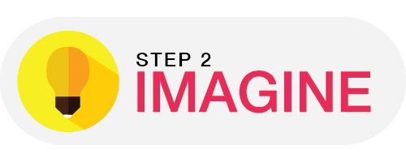
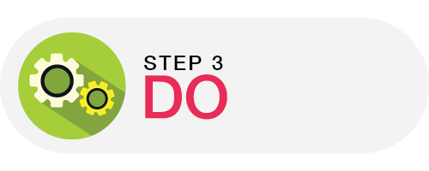
4 STEP Design Thinking Process
Feel
What bothers me the most
Find out people like you who face the similar problem
Imagine
Brainstorm different ways to solve the problem
Do
Build a working prototype/model which solves the problem
Share
Test it with people who face the problem
Listen to their feedback
Upcycle and modify

Slide 6
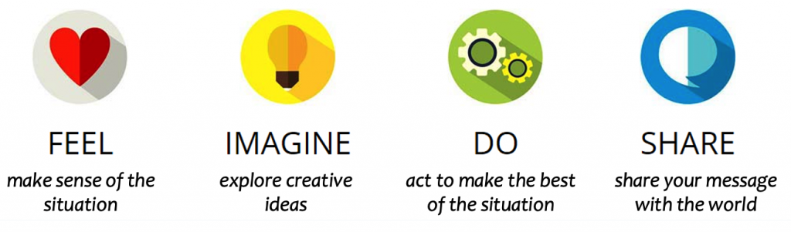
Feel
The first step to creating meaningful change
try and understand how people feel and become more aware
encourage children to look at their surroundings closely,
talk to people involved
understand multiple perspectives.
It all begins with Empathy
Develop deep understanding of the users and their problems
Think from your heart
Notes:
https://www.youtube.com/watch?v=XKEFMBF0QbA&feature=emb_logo

Slide 7
Imagine
All ideas are worth considering
Work together, involve your friends and brainstorm different ideas
Building on one another’s ideas.
The clearer you IMAGINE the solution, the better you can DO it
The best idea, is the idea which gives better solution(even if it’s one of the wild ones)!
Think broadly and explore the challenge.
Generate a wide range of possible solutions.
Describes the details about the user’s problem.
The problems stated are user centered, focusing mainly on difficulties, barriers and requirements
This phase helps us in developing a creative solution to stated problems, where all new angles and ideas are brainstormed
At the end of the phase few profitable ideas are taken forward for next stage.
Visualize Change
Notes:
https://www.youtube.com/watch?v=XNqABXOBrMI

Slide 8
Do
It’s time to Be The Change!
Pick the idea that is most likely to impact the maximum people positively,
Get down to the details
Build models of the ideas to check how the solutions work
It can be a simple model or an on paper deign or a more detailed and complex model.
Build Your First Prototype
Go over everything, from budget to resources and assignments and rely on teamwork to get it done!
Make Change Happen
Notes:
https://www.youtube.com/watch?v=pEd90FlQypw&feature=emb_logo

Slide 9
Share
Let the user test the prototype to see how it works in real-time
Follow Show Don’t Tell
User might produce new challenges
Take them and upcycle (Back to Feel-Do-Imagine)
Understand areas for improvement.
Make everyone in the world to be invited for this journey
The best progress is always together!
Share your story with the world
If I CAN, You can too!
Notes:
https://www.youtube.com/watch?v=jeGLsYsHyko&feature=emb_logo

Slide 10
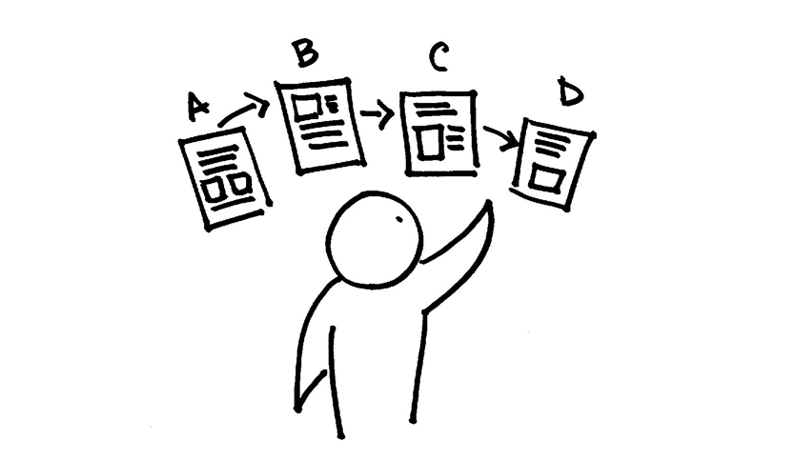
Iterate-Iterate-Iterate
The process of Feel -> Imagine -> Do -> Share goes on until a solution which addresses the pain of the user more holistically
Sharing helps the designer recognize new challenges faced by the user.
Here the process goes back to Imagine.
It also helps understand the improvements required.
Here the process goes by to Do.

Slide 11

Let us solve a problem

Slide 12
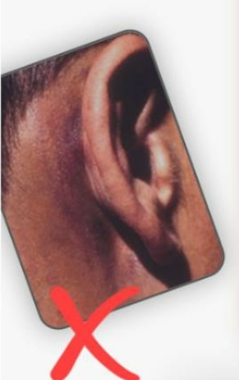
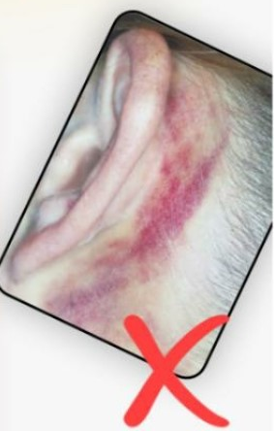
What is the problem?
People who wear face-mask for longer time
Ears are chaffed
Some of the examples
WHO WEARS THESE MASKS?
List them down
Note the duration for which they wear the face mask
How many of you all have used Face Mask?

Slide 13
WHO IS THE USER?
WHY DO I WEAR A MASK?
Keep myself safe during COVID?
To avoid dust-allergy or other kind of allergies
Profession of the People who uses face-mask regularly
Policemen
Staff Nurse
Doctors on duty
Bank Officials
ASHA Workers
Shopkeepers
Some Questions to ponder
How long I wear a mask in a day?
Do I breathe comfortably while mask is on?
What are the different types of mask I wear?
What are the different types of masks are available?

Slide 14
IMAGINE
For whom we’re designing a mask
For Policemen
For Doctors
Describe your USER
Name
Age
Profession
Duty Hours
Location
No of family members
Size of the house
More about user
What does the user feel?
What does user see?
What does user do?
What does user hear?
Whom would you like to design it for?

Slide 15
Build the PROTOTYPE
Points to remember
Can we reduce ear chafing
It hurts back of the ear
Uncomfortable while breathing
Think of the material that can be used
Head/Hairs and Eyes are exposed in existing mask
Remember these questions
What does the user feel?
What does user see?
What does user do?
What does user hear?
Lets work towards a solution

Slide 16
SHARE Design of a Face-Mask

Slide 17

THANK YOU

